Slide 1
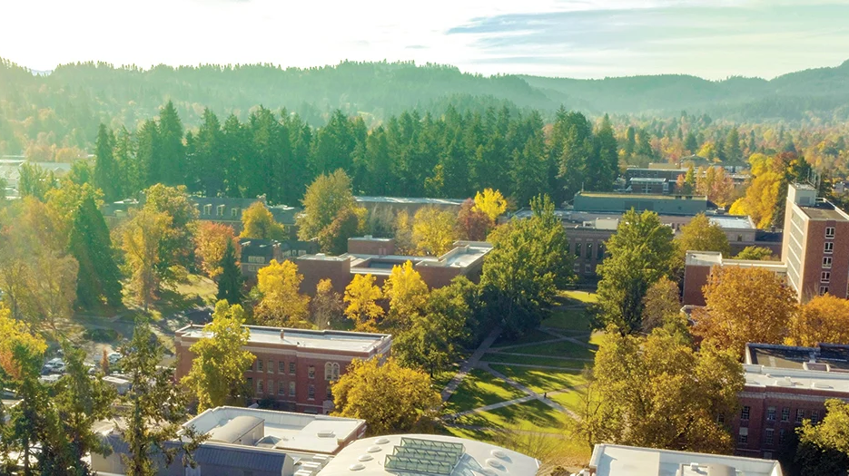
Why might graduate students go on strike?
The Graduate Teaching Fellows Federation (GTFF) is the union representing the graduate workers at the University of Oregon. Their members have voted to authorize a strike.

Slide 2
Graduate Employees are Graduate Students Graduate Student funding is different from undergraduate funding
Your GE’s are graduate students here studying to get an advanced degree or credential.
The majority of graduate students are funded entirely through GE’ships.
Notes:
When graduate students are admitted into their programs they are usually offered a financial package, the University of Oregon relies on GEships

Slide 3
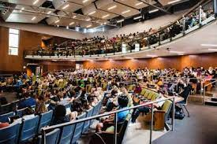
The University of Oregon Needs Graduate Student Labor
Graduate Employees provide a level of expertise that is needed to provide undergraduate education:
Teach Sections
Teach Labs
Grade undergraduate work
Provide administrative work for special projects
Teach Courses as Instructor of Record
Do research that elevates the profile of the UO

Slide 4
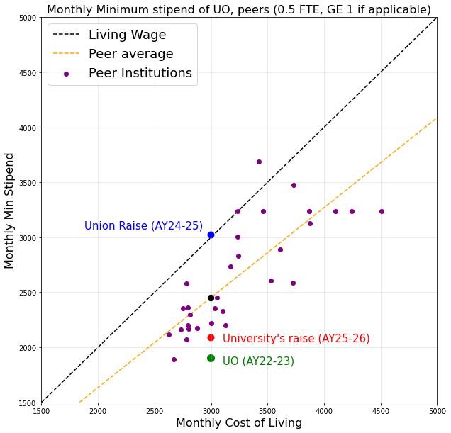
Yet GE pay is still much lower than most universities across the country

Slide 5
The GTFF negotiates with UO administration to determine wages and working conditions of graduate employees.
The cost of living (in particular, housing) in Eugene has increased dramatically since the pandemic.
The wages of graduate employees have not kept up with inflation.
Graduate unions at many other institutions have gone on strike in the last year and won significant wage increases.
If UO is to be competitive in graduate recruitment, our graduate salaries need to be competitive.

Slide 6
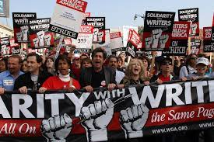
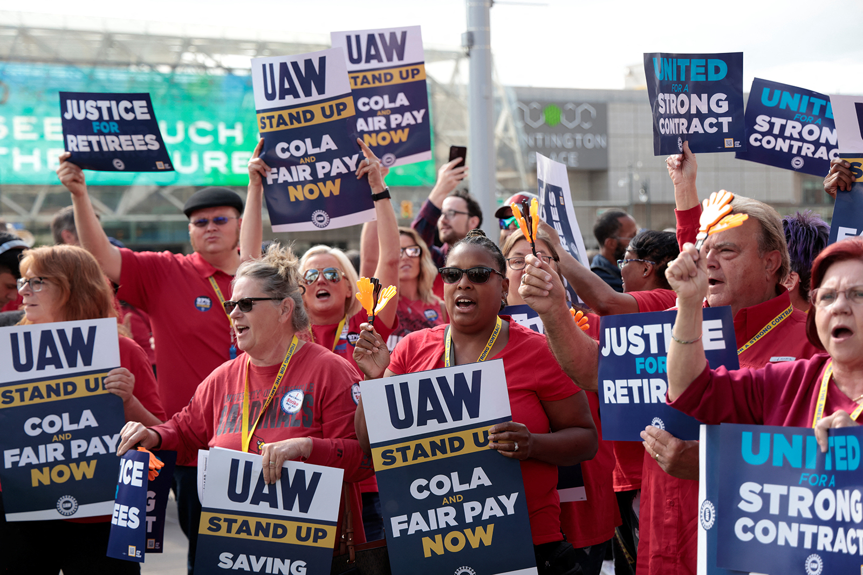
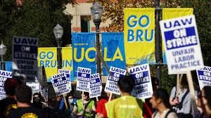
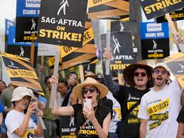
This Historical Moment
Graduate Student Strikes Across the Country
At Rutgers, striking graduate workers won raises, bringing their salary up from around $30,000 in the first year to $40,000 in the fourth year of their contract.
Grads in the University of California system will see 10 percent increases in the first year of the contract, with 6.4 percent increases in each subsequent year, with higher salary floors for graduate students in particularly expensive housing markets.
At the University of Michigan, striking grads won an 8 percent raise in the first year of the contract, a 6 percent raise in the second year and another 6 percent raise in the third year for graduate student instructors and staff assistants at the university’s Ann Arbor campus.
At Temple University, after striking, graduate students won increases to salary floors which are equivalent to a 23.1 percent increase in the first year. By the end, in 2026, grad workers will make about 30 percent more overall, moving them from $19,500 to $27,000
You are a part of this history!

Slide 7
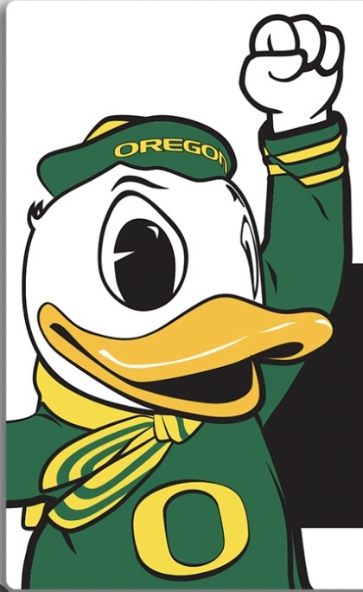
What can you do to support striking graduate students?
Strikes are about disruption. Be understanding and patient as the disruption plays out.
The job of GEs during a strike is to demonstrate the importance of their labor by withholding it. Refrain from asking your GEs to work during the strike.
Write to the UO president and let them know you, as a current student, support the GTFF demands.
Be patient with your (non-graduate) instructors; they may be demonstrating solidarity by not taking on the labor of striking GEs.
Talk to your peers about the GTFF strike.

